Slide 1



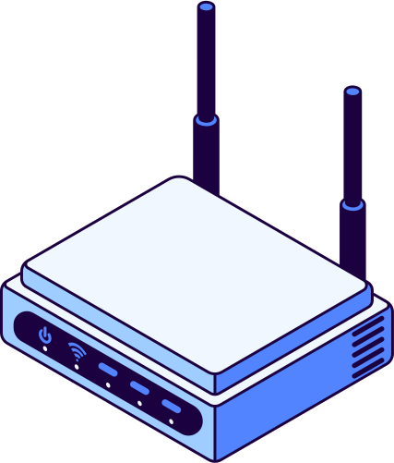

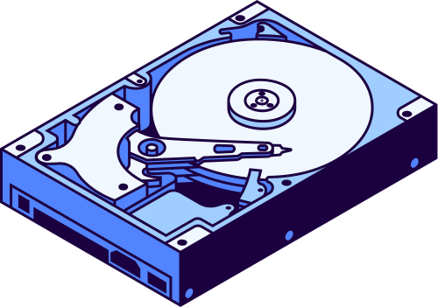
Network
Infrastructure Models
Presenter : Aisyah Currents
Student id : 25091397108
Class : International
Study Program - Informatics Management
Faculty of Vocation
Universitas Negeri Surabaya

Slide 2

Introduction
Network infrastructure is a collection of hardware, software, services, and protocols used to connect computers, servers, and other devices so they can communicate with each other. It includes routers, switches, cables, access points, servers, as well as supporting technologies like firewalls and security systems. Its main goal is to provide stable, secure, fast, and reliable connections for data exchange..

Slide 3

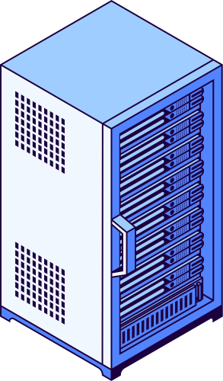
Types of Network Infrastructure Models
1. Peer-to-Peer (P2P) Model
In a peer-to-peer network, every device can act as both a client and a server, sharing resources directly with one another. This model is simple to set up and cost-effective, making it ideal for small networks or home environments. However, it can become difficult to manage as the network grows, and security is generally limited.
2. Client-Server Model
The client-server model relies on a central server that provides resources or services to multiple client devices. This setup makes management and security easier, and it can support medium to large networks efficiently. While it offers better control and organization, the central server can become a bottleneck or single point of failure if not properly maintained.

Slide 4
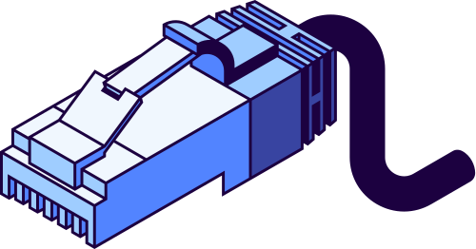

3. Distributed Model
In a distributed network, resources and processing tasks are spread across multiple servers rather than centralized in one location. This approach improves reliability and performance by reducing the load on any single server and increasing fault tolerance. It is commonly used in systems like Content Delivery Networks (CDNs) that require high availability and speed.
4. Cloud-Based Model
Cloud-based infrastructure hosts resources and services on remote servers accessed via the internet. This model offers remarkable scalability and flexibility, allowing organizations to adjust resources based on demand. It is cost-efficient and reduces the need for extensive on-site hardware, though it depends heavily on internet connectivity and the reliability of cloud service providers.

Slide 5

Security Considerations
Ensuring the security of a network infrastructure is essential to protect sensitive data and maintain smooth operations. Key measures include encrypting data to prevent unauthorized access, implementing firewalls and intrusion prevention systems to block potential threats, and keeping software and hardware up to date with regular patches. Additionally, controlling access through authentication and permission management ensures that only authorized users can reach critical resources, helping organizations maintain a secure and reliable network environment.

Slide 6


CONCLUSION
Network infrastructure models are the foundation for designing, managing, and securing communication systems. Each model has its own strengths and limitations depending on organizational needs. Understanding these models helps organizations select the most suitable structure that ensures efficiency, scalability, and security while supporting smooth business operations and future growth.

Slide 7

Thank You!

